Slide 1
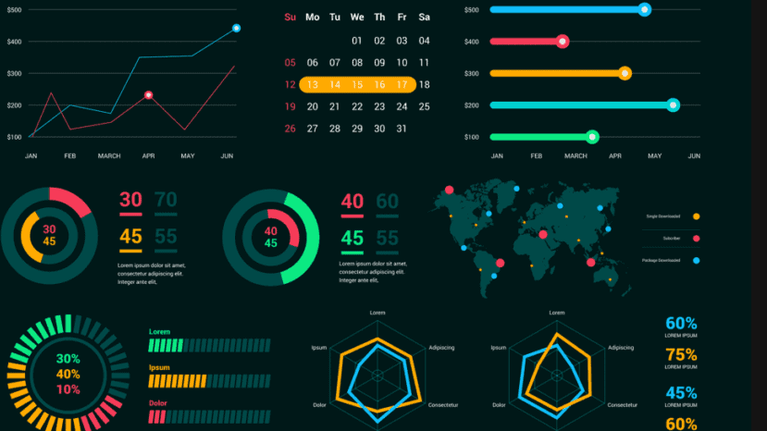
EG431D Data Acquisition
Data Visualization

Slide 2
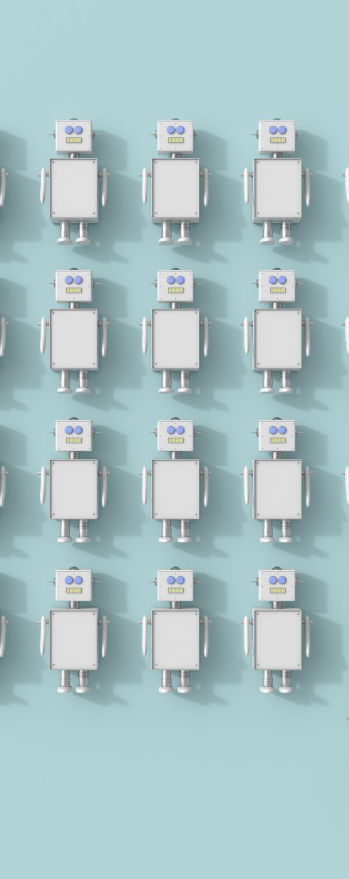
Objectives
Understand the core principles of data visualization.
Learn real-time visualization using edge devices and cloud dashboards.
Explore trends in visualization technologies, including edge computing and IoT.
Demonstrate transforming raw data into visual formats.
Select suitable visualization methods for specific data characteristics.

Slide 3
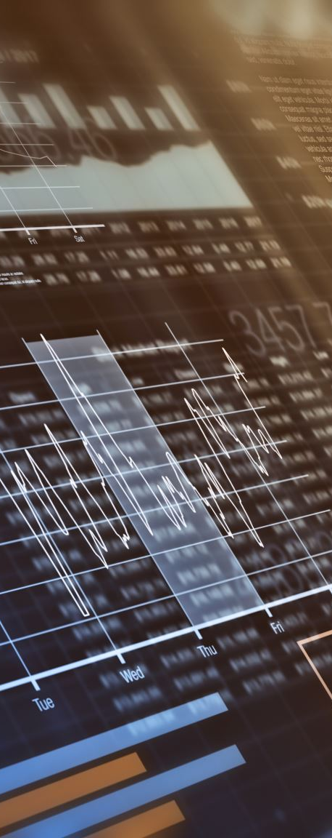
Overview of Data Visualization
Definition: Transforming data sets into visual formats to reveal patterns, trends, and insights.
Importance: Enhances data comprehension and decision-making.
Applications:
Industrial monitoring.
Environmental tracking.
System performance analysis.

Slide 4
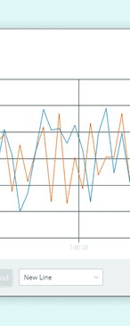
Arduino IDE Built-in Tools
Serial Monitor: Displays real-time text-based data from sensors.
Serial Plotter: Provides graphical visualizations for trends and patterns.
Benefits:
Debugging and real-time monitoring.
Quick insights without external tools.

Slide 5
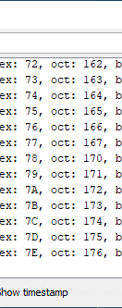
Demonstrating the Serial Monitor
Setup:
Use Arduino MKR WiFi 1010 and AMG8833 TSA Sensor.
Load and run tempTSA_ST.ino sketch.
Output: Real-time temperature array displayed on the Serial Monitor.
Key Feature: Customizable data formatting using Serial.print().

Slide 6
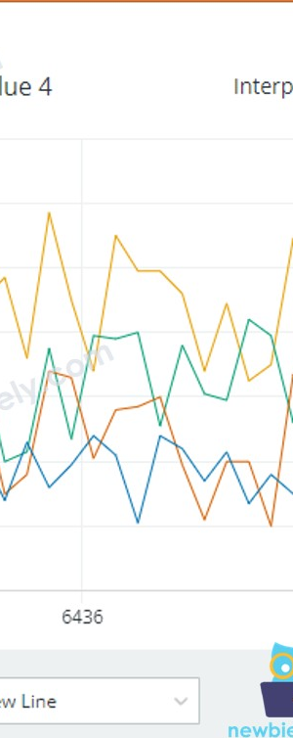
Demonstrating the Serial Plotter
Setup:
Use Arduino MKR WiFi 1010 and Digital Light Sensor.
Load and run lightSensorIR_SP.ino sketch.
Output: Real-time line plots of IR and full-spectrum light intensity.
Feature: Simultaneous visualization of multiple data sets.

Slide 7
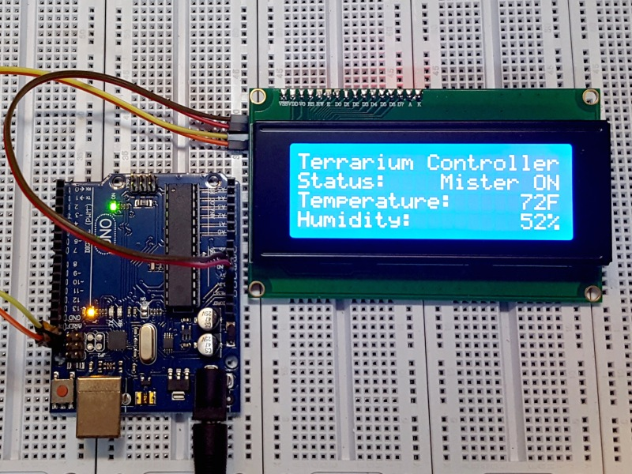
On-the-Edge Visualization Tools
LED Indicators: Simple visual cues for operational states.
Example: Temperature thresholds.
Alphanumeric LCDs: Text-based real-time feedback.
Example: Displaying heart rate and oxygen saturation.
Advantages: Localized and immediate feedback.

Slide 8
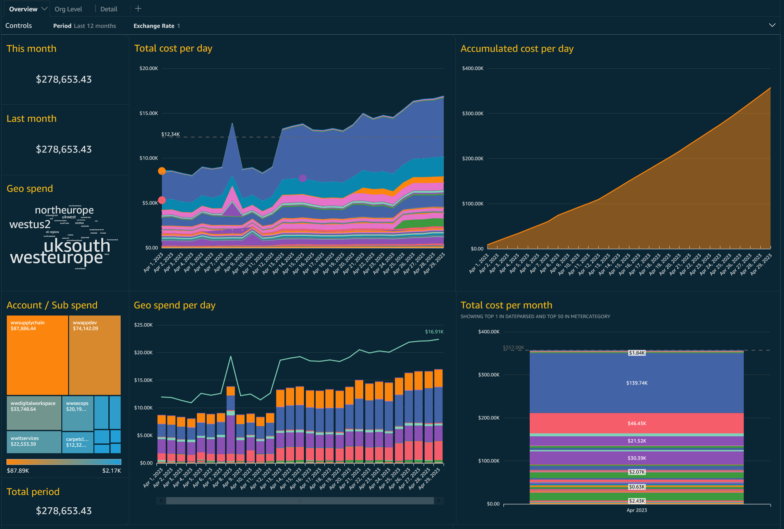
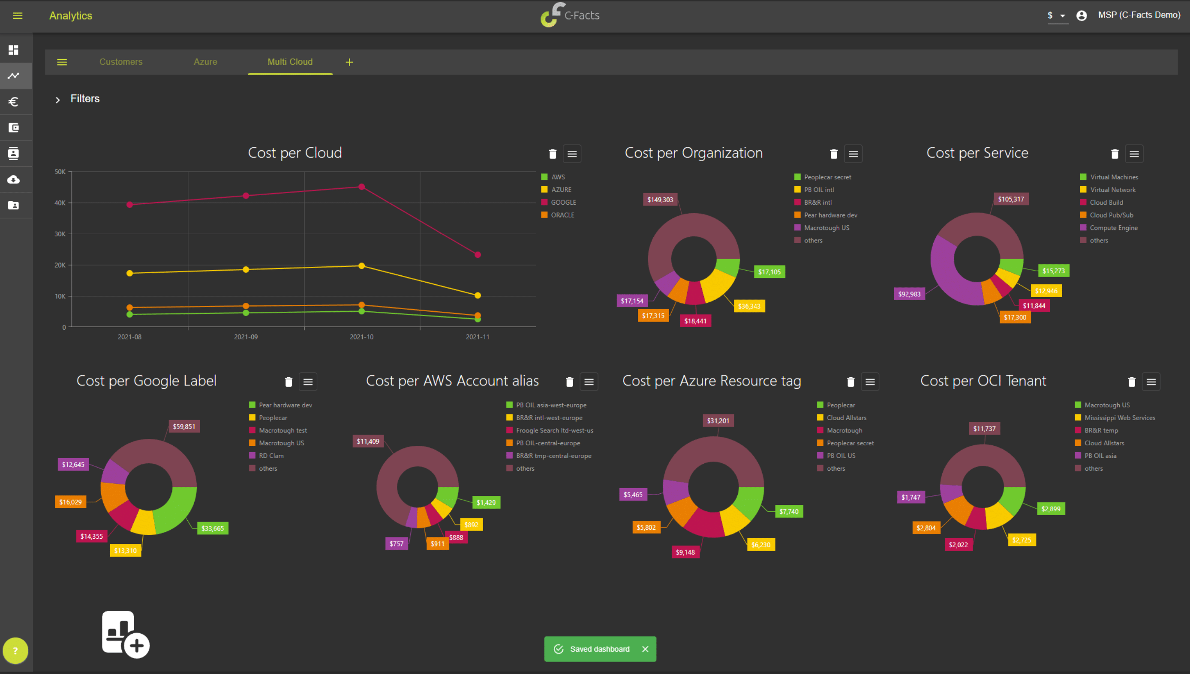
Cloud Dashboards Overview
Definition: Online platforms for real-time data visualization and management.
Examples: AllThingsTalk, ThingSpeak.
Benefits:
Remote monitoring.
Scalable and interactive dashboards.

Slide 9
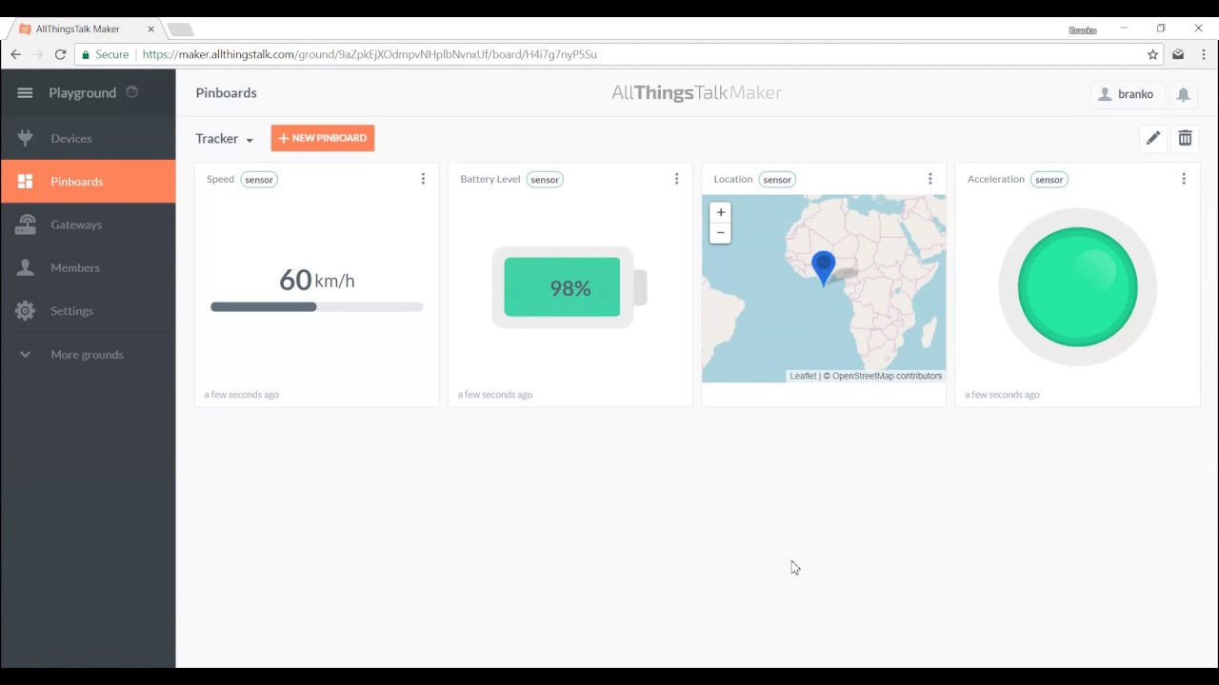
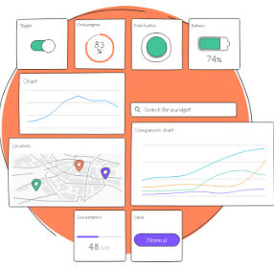
AllThingsTalk Platform
Features:
Real-time data visualization.
Rule-based automation.
Multi-protocol support (MQTT, LoRaWAN).
Example: Monitoring CO2, temperature, and humidity.
Advantages: Ease of integration and scalability.

Slide 10
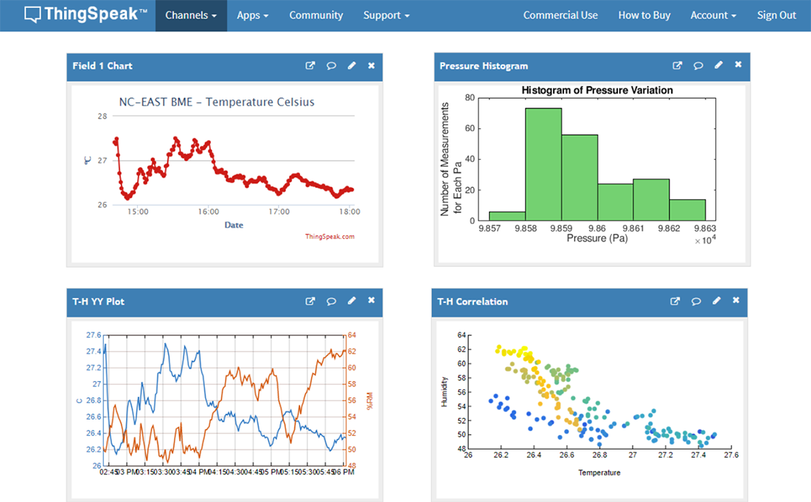

ThingSpeak Platform
Features:
Advanced data analysis with MATLAB integration.
Customizable dashboards.
Historical data storage and predictive modeling.
Example: Smart home monitoring with temperature, sound, and light sensors.

Slide 11
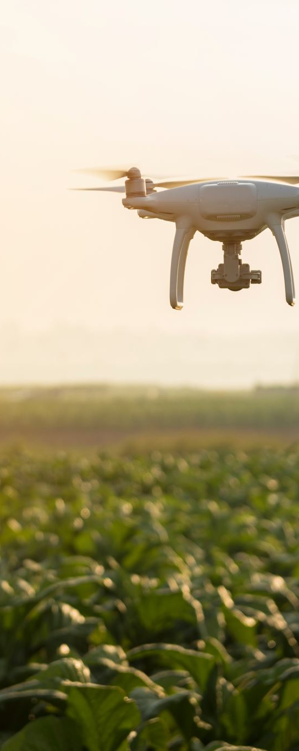
Summary
Data visualization transforms raw data into actionable insights.
Tools range from local devices (LEDs, LCDs) to advanced platforms (AllThingsTalk, ThingSpeak).
Selecting the right tool depends on project requirements.

